Slide 1
Line Graph
import matplotlib.pyplot as mat
x=[1,2,3]
y=[5,7,4]
mat.plot(x,y,label='First')
mat.xlabel('Cost')
mat.ylabel('Speed')
mat.title('Analysis Graph')
mat.legend()
mat.show()

Slide 2
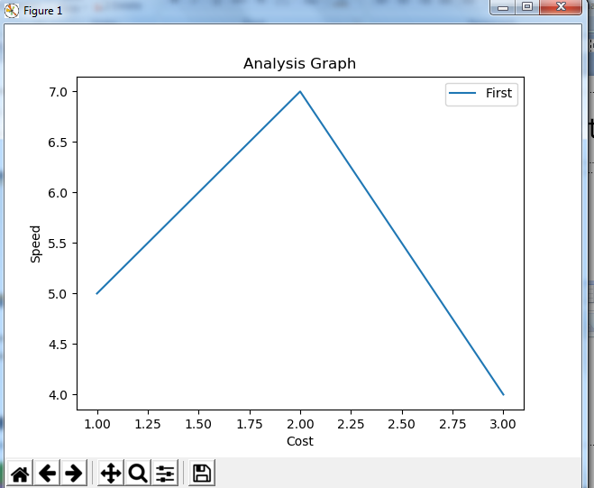

Slide 3
import matplotlib.pyplot as plt
views=[534,258,689,401,724,689,350]
days=range(1,8)
plt.plot(days, views,
label='Youtube viewership', color='k', marker='D',
markerfacecolor='r',ls='-.',lw=3)
plt.xlabel ('Number of days')
plt.ylabel('Youtube views')
plt.legend()
plt.title("Viewer graph for youtube videos")
plt.show()

Slide 4
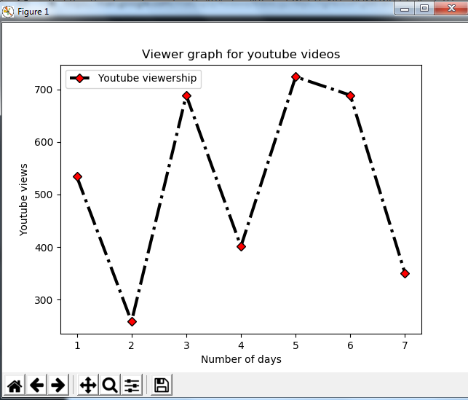

Slide 5
Save as pdf
import matplotlib.pyplot as mat
x=[1,2,3]
y=[5,7,4]
mat.plot(x,y,label='First')
mat.xlabel('Cost')
mat.ylabel('Speed')
mat.title('Analysis Graph')
mat.legend()
mat.savefig("d:/neha.pdf",format="pdf")
mat.show()

Slide 6
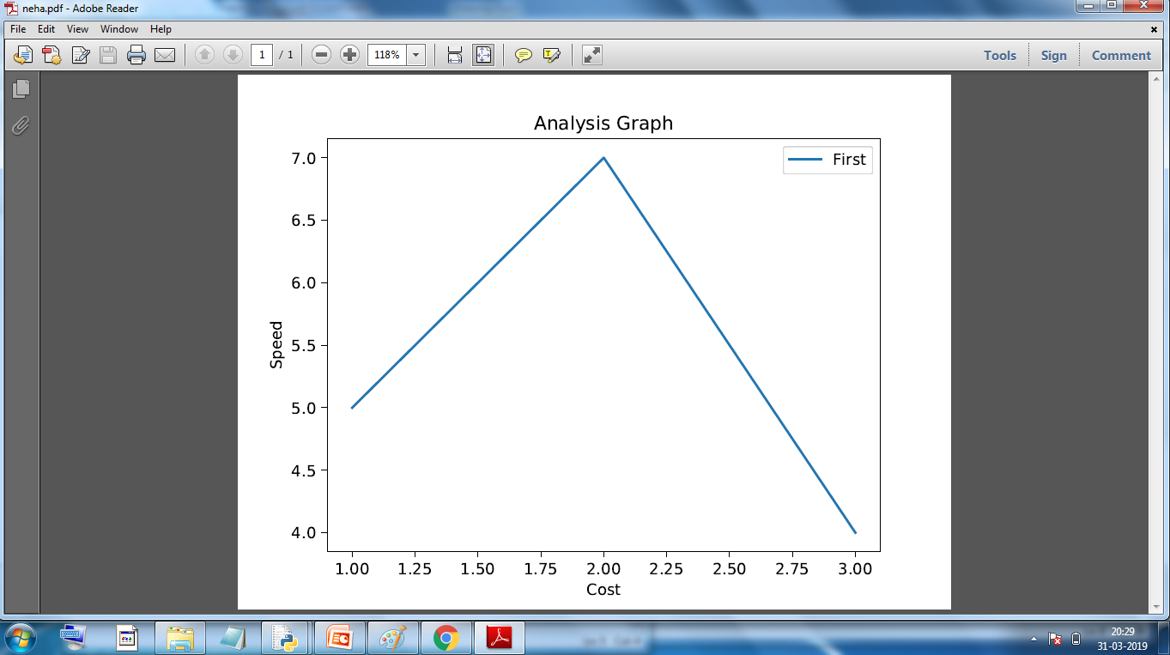

Slide 7
Plotting two lines
import matplotlib.pyplot as mat
x1=[1,2,3]
y1=[5,7,4]
x2=[1,2,3]
y2=[5,14,12]
mat.plot(x1,y1,label='First',color='cyan')
mat.plot(x2,y2,label='Second',color='g')
mat.xlabel('Cost')
mat.ylabel('Speed')
mat.title('Analysis Graph')
mat.legend()
mat.show()

Slide 8
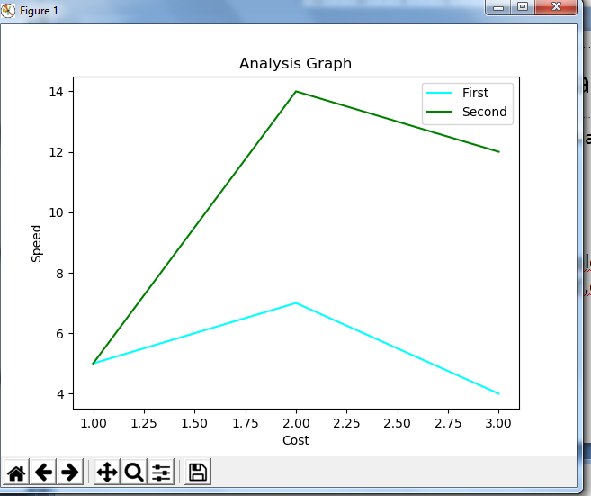

Slide 9
Line style and width
import matplotlib.pyplot as mat
x1=[1,2,3]
y1=[5,7,4]
x2=[1,2,3]
y2=[5,14,12]
mat.plot(x1,y1,label='First',color='cyan',ls='-.',linewidth=10)
mat.plot(x2,y2,label='Second',color='g')
mat.xlabel('Cost')
mat.ylabel('Speed')
mat.title('Analysis Graph')
mat.legend()
mat.show()

Slide 10
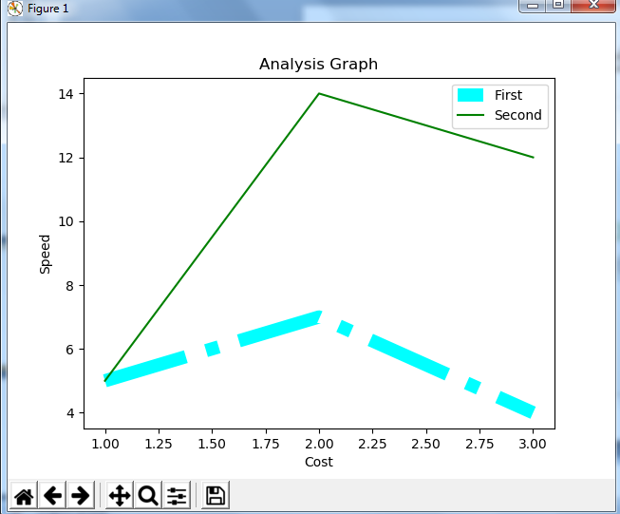

Slide 11
Pie Chart
import matplotlib.pyplot as mat
x=[11,33,44,12,99]
y=['java','c','python','php','dotnet']
mat.pie(x,labels=y)
mat.show()

Slide 12
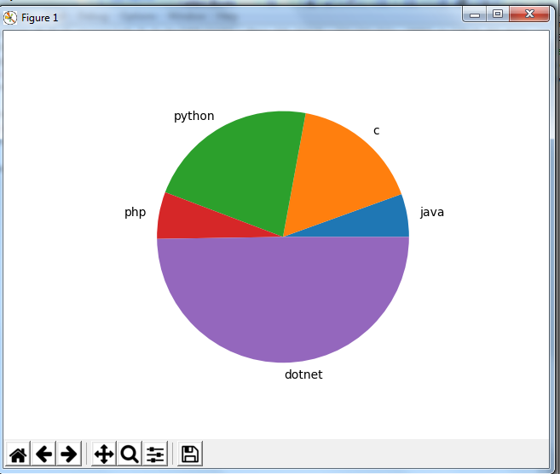

Slide 13
import matplotlib.pyplot as mat
x=[11,33,44,12,99]
y=['java','c','python','php','dotnet']
color=['red','green','y','k','b']
mat.pie(x,labels=y,colors=color)
mat.show()

Slide 14
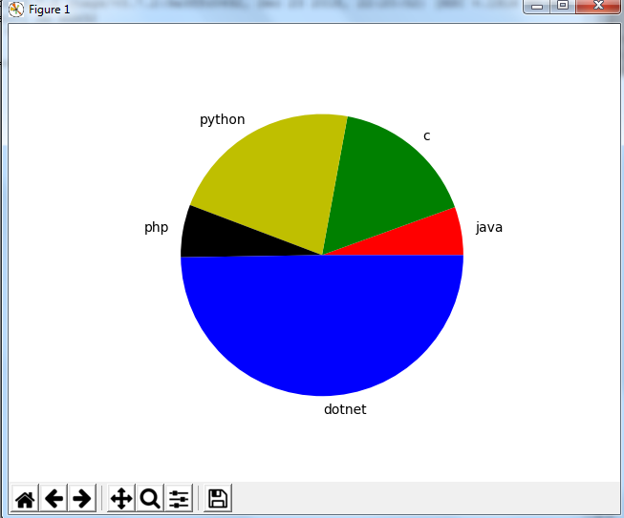

Slide 15
import matplotlib.pyplot as mat
x=[11,33,44,12,99]
y=['java','c','python','php','dotnet']
color=['red','green','y','k','b']
ex=[0,0,0.2,0,0.5]
mat.pie(x,labels=y,colors=color,explode=ex)
mat.show()

Slide 16
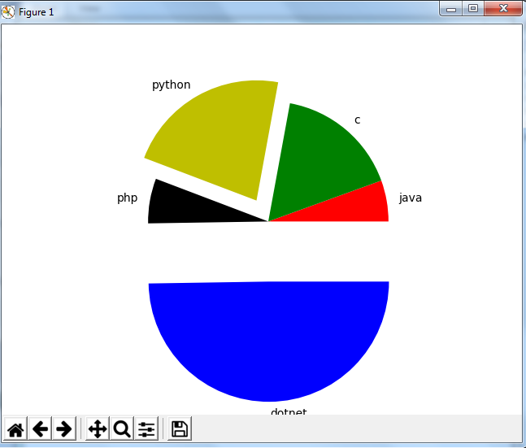

Slide 17
import matplotlib.pyplot as mat
x=[11,33,44,12,99]
y=['java','c','python','php','dotnet']
color=['red','green','y','k','b']
ex=[0,0,0.2,0,0.5]
mat.pie(x,labels=y,colors=color,explode=ex,
shadow=True)
mat.show()

Slide 18
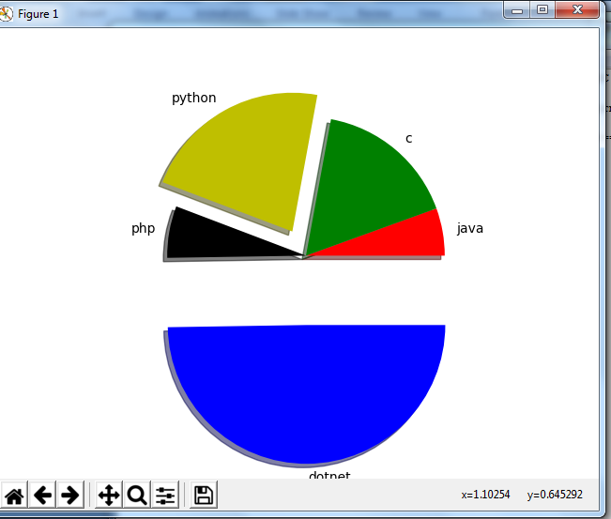

Slide 19
import matplotlib.pyplot as mat
x1=[1,2,3,4,5]
x2=[11,12,13,14,15]
y=[5,2,1,3,6]
mat.scatter(x1,y,label=“cost p",color='c')
mat.scatter(x2,y,label=“selling p",color='magenta')
mat.xlabel("x")
mat.ylabel("y")
mat.title("scatter")
mat.legend()
mat.show()

Slide 20
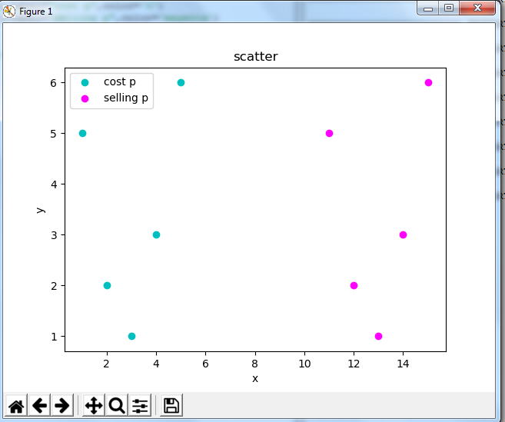

Slide 21
Histogram
import matplotlib.pyplot as mat
viewer=[24,22,33,85,41,82,55,88,1,4,99,81,38]
age=[0,10,20,30,40,50,60,70,80,90,100]
mat.hist(viewer,age,color='g',rwidth=0.5)
mat.title("histogram")
mat.show()

Slide 22
